Slide 1

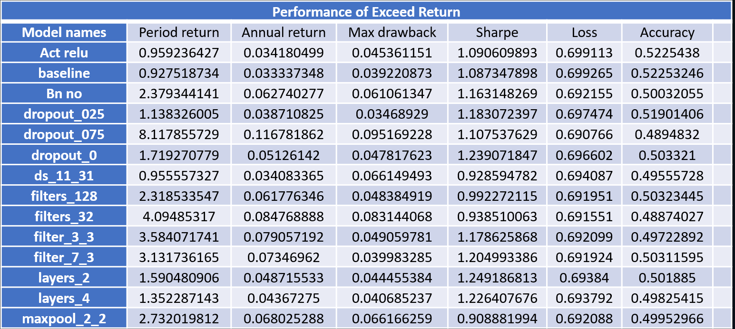

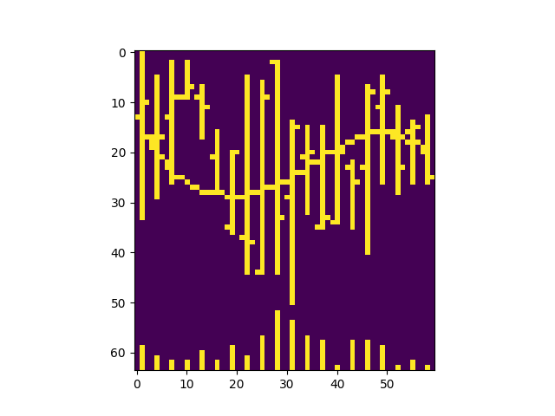
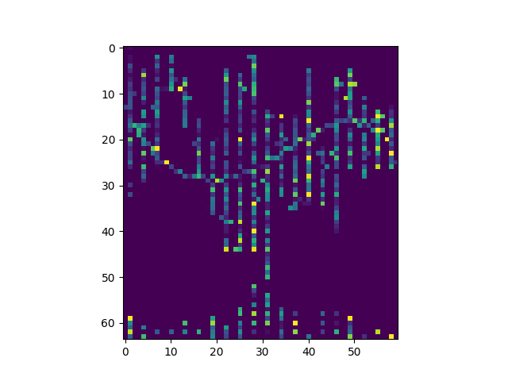
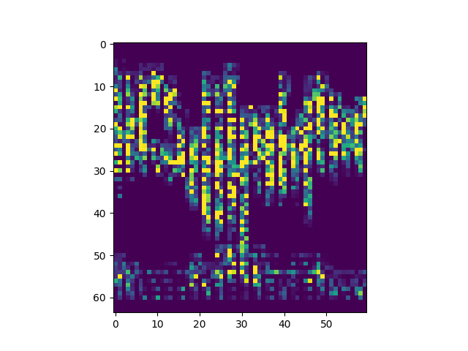
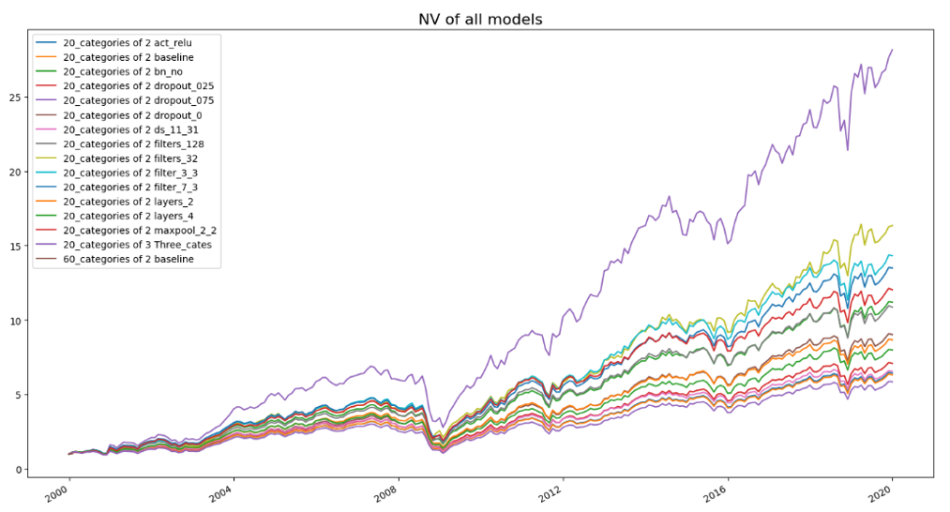
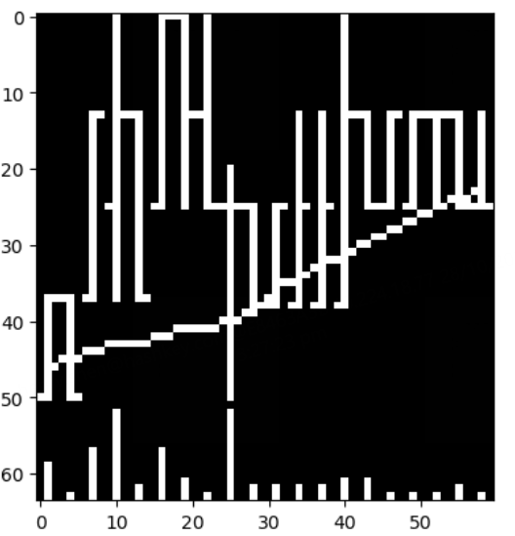
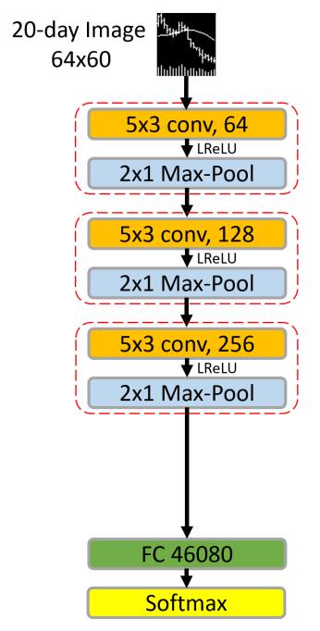
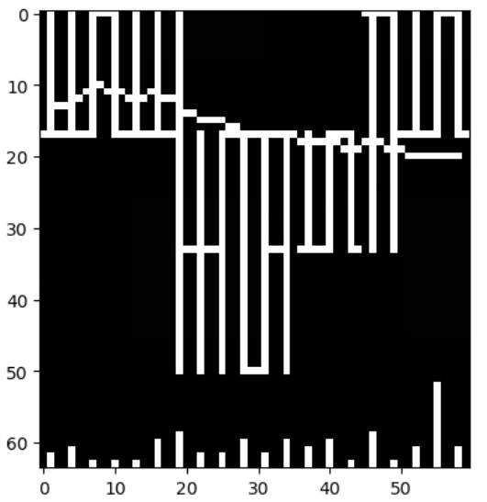

MAFS 5440 Project 2 – Paper replication II: (Re-)Imag(in)ing Price Trends
Team Members: Qichuan Chen, Hengyu Shen, Sihan Yang, Yichen Zhu
Financial Mathematics - HKUST
1. Replication Workflow & Extension Directions
2. Sensitivity & Ablation Analysis
4. Multi – Classification
Research Background: The original paper aims to predict future stock price trends by converting price data into grayscale images and using Convolutional Neural Networks (CNN) for forecasting. Unlike traditional numerical time series, image data allows the model to automatically extract complex patterns without manually setting features (Data). In the experimental setup, the authors divided samples into training, validation, and test sets by time periods and optimized the model using a cross-entropy loss function (Experiment Setting). The CNN model’s capability for automatic feature extraction and noise resistance makes it especially suitable for identifying hard-to-describe price patterns in financial markets (Model).
Replication Approach: In this project, we will replicate the method outlined in the original paper to establish a baseline model, which will serve as a foundation for further research extensions, including:
Sensitivity Analysis: Changing one parameter at a time to observe differences in loss and relevant backtesting parameters between the new model and the baseline model.
CNN Model Visualization
Multi - Classification Model
Trading Backtesting of Model Signals
To analyze the sensitivity of the CNN model to parameter changes, we adjusted various parameters—such as the number of convolutional layers and filter sizes—and observed the model’s loss under each configuration. The table below presents the specific performance of each model in this sensitivity analysis.
Furthermore, we changed model labels as an extension for the basic model. Firstly, we made three-classification labels by dividing condition Ret_20>0 into to sub-conditions, which are Ret_20>Ret_5 and not. We choosing assets with positive Ret_20 and momentum during day 5-2. Secondly, we use 20-days image to predict Ret_60 and choose assets with positive Ret_60. This is an attempt to find whether 20-days image can be a good predictor for Ret_60. Model performance is shown below.
5. Backtesting Result
For labels with Ret_20 and three-classification, we change our portfolio every 20 days, for labels with Net values of equal weight portfolio for our above 16 models is shown in the graph below.
Backtesting result of all CNN models outperform market equal weight portfolio. The model which dropout 75% neuron in fc get the best performance, which earned over 27 times return during backtesting period.
1993 - 1999
3. CNN Visualization
To interpret the internal mechanisms of the CNN model, we used two visualization methods.
Integrated Gradients: This method calculates the importance of each pixel, helping to identify image areas that most significantly impact the model’s decisions. By visualizing each pixel's contribution, we can see which specific regions are critical to the prediction, thereby providing clearer insights into the model's decision-making basis.
Guided Grad-CAM: As a variant of Grad-CAM, Guided Grad-CAM generates heatmaps to show areas of focus within the model at different convolutional layers. By examining activation maps in both shallow and deep convolutional layers, we gain an understanding of how the model progressively extracts and abstracts features from the raw image.
Training
Validation
6. Reference
30%
70%
Jiang, Jingwen and Kelly, Bryan T. and Xiu, Dacheng, (Re-)Imag(in)ing Price Trends (December 1, 2020). Chicago Booth Research Paper No. 21-01, http://dx.doi.org/10.2139/ssrn.3756587
min cross-entropy loss
7. Contribution
Testing
CHEN Qichuan: Model Backtest
SHEN Hengyu: Sensitivity Analysis
YANG Sihan: Multi – Classification Model
ZHU Yichen: CNN Visualization
2000 - 2019

